Slide 1

RETAIL DW BY Hem Bhupaal Reddy Sai Ikshith Indugu Chandan KM

Slide 2
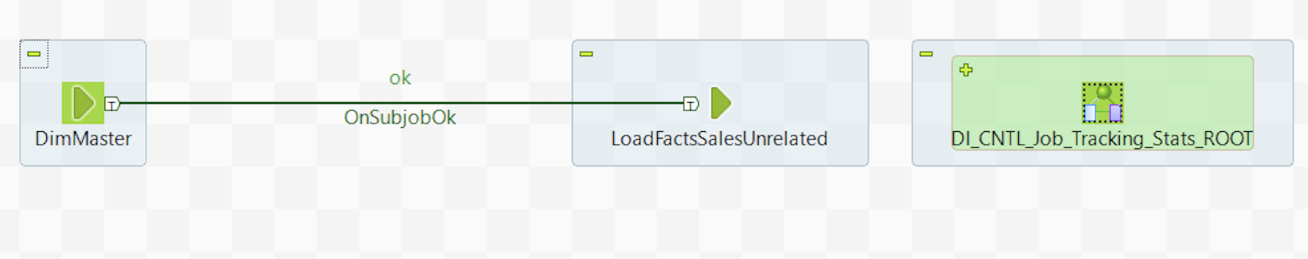
MASTER JOB
LOADS ALL THE DIMENSIONS AND FACTS IN ONE GO

Slide 3
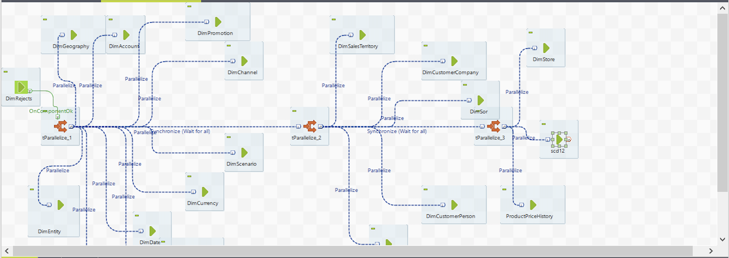
LOADS ALL THE DIMENSIONS
LOADS ALL THE DIMENSION TABLES IN THE SPECIFIED SEQUENCE

Slide 4
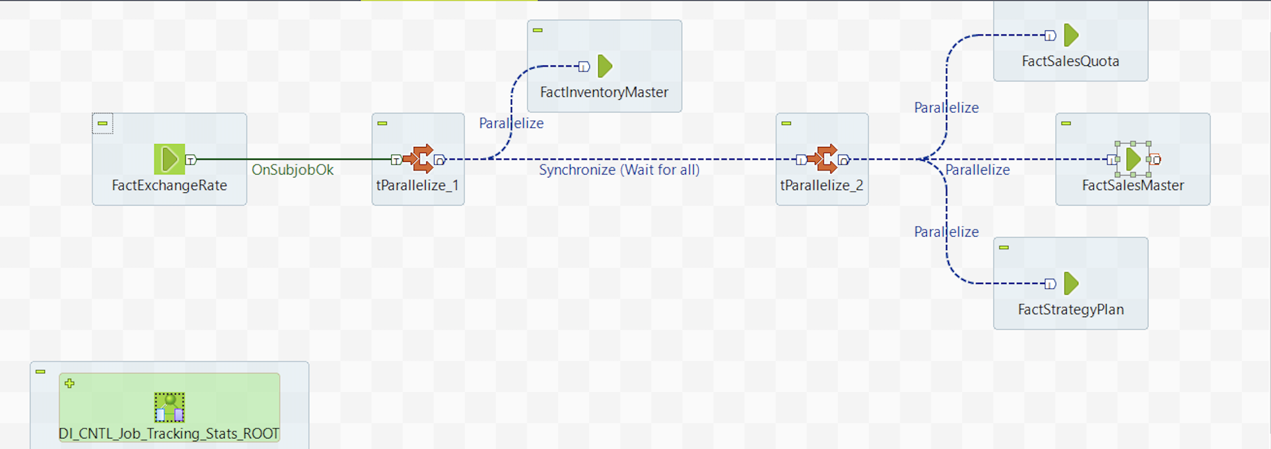
LOADS ALL THE FACT TABLES
LOADS ALL THE FACT TABLES IN THE SPECIFIED ORDER

Slide 5
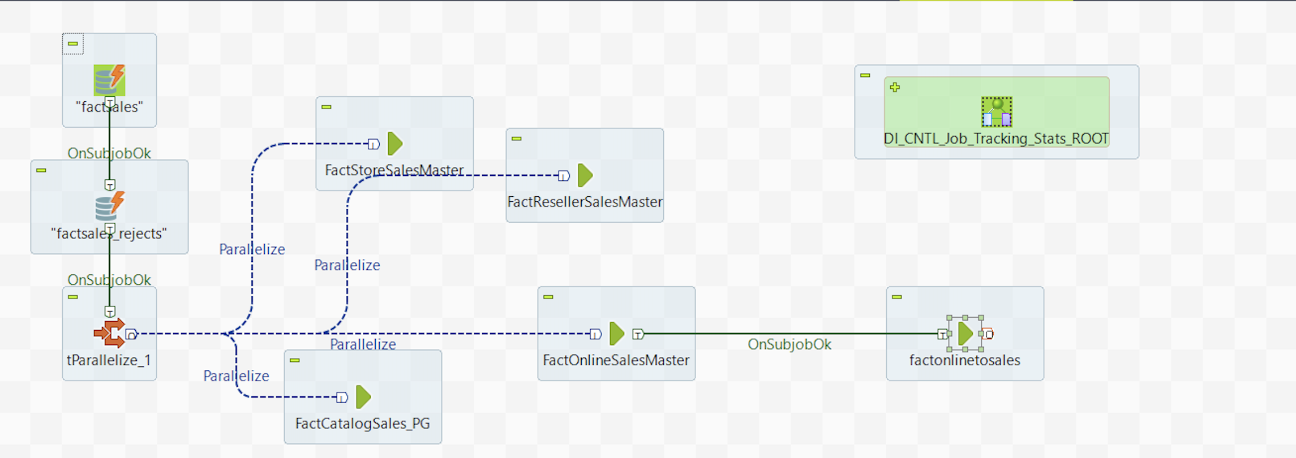
LOADS ALL SALES FACTS
SALES RELATED FACTS

Slide 6
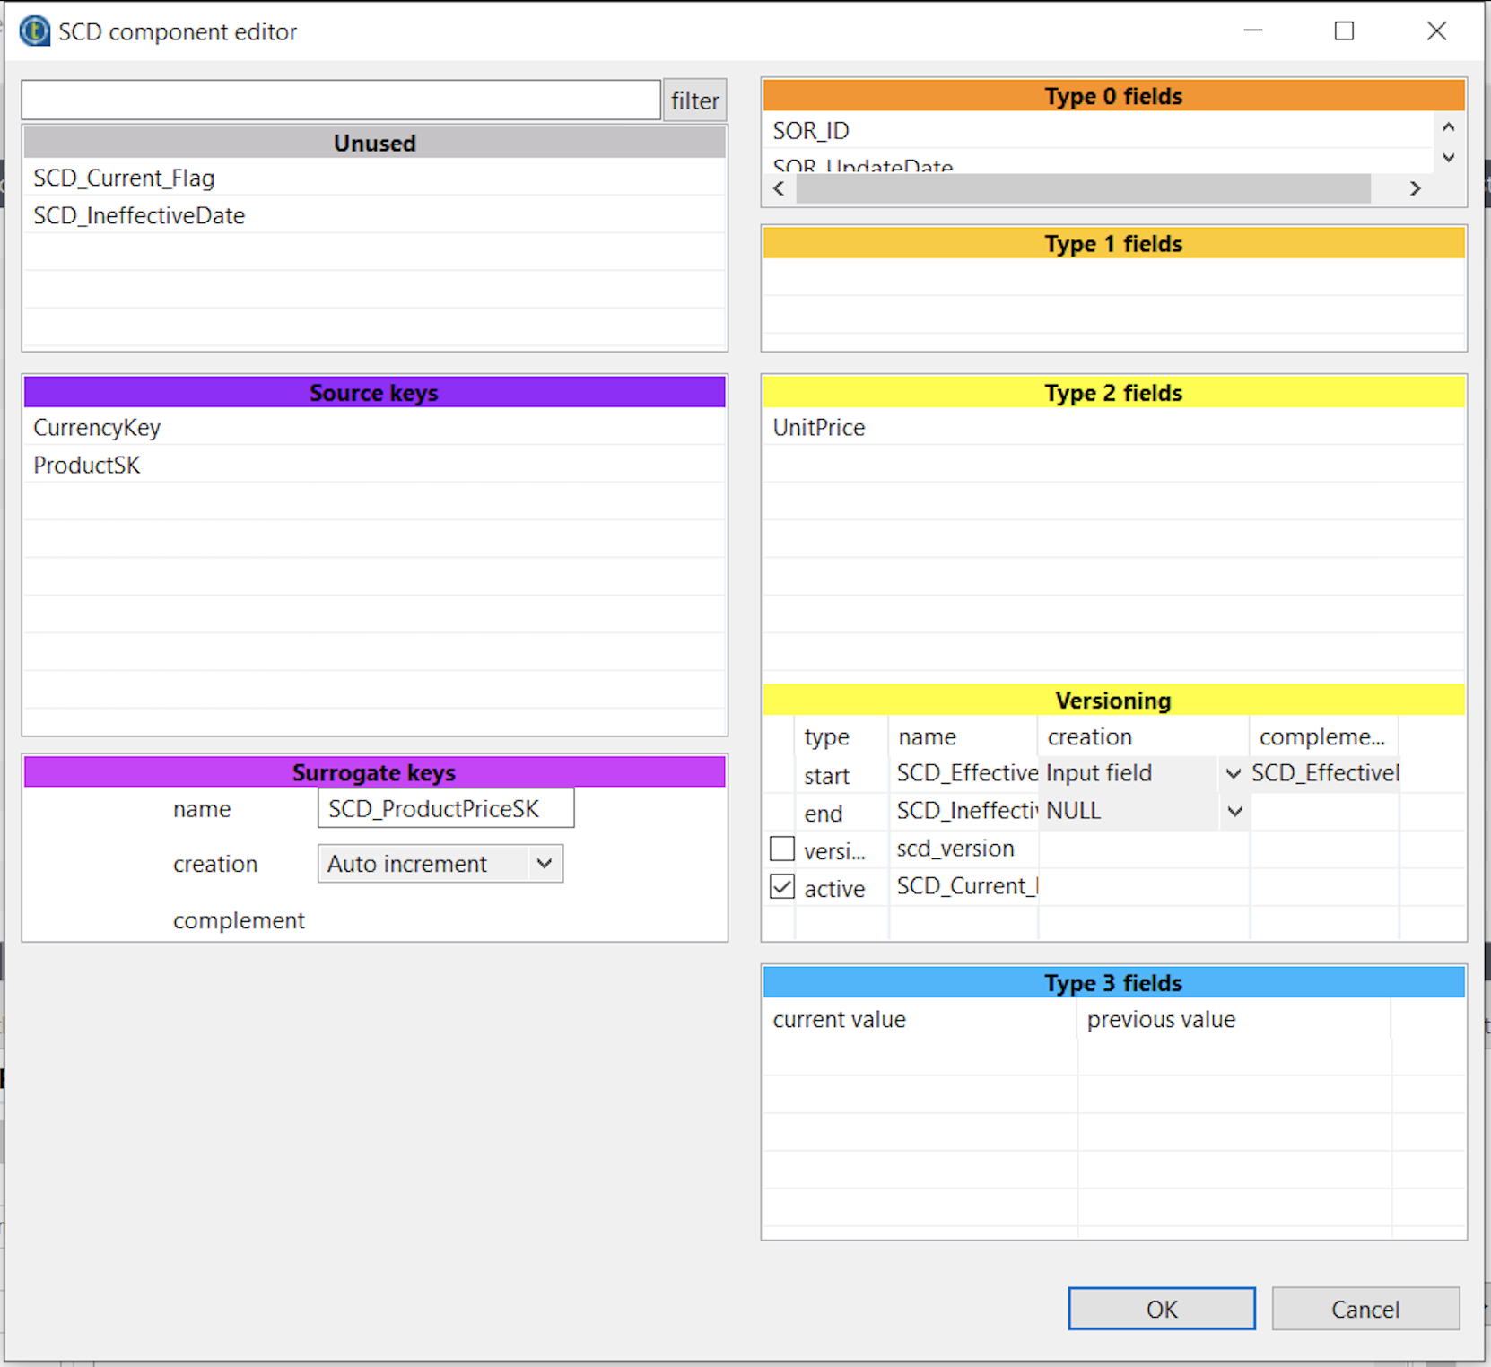
PRODUCTPRICEHISTORY SCD
PRODUCTPRICE IS A SCD TYPE2 FIELD

Slide 7
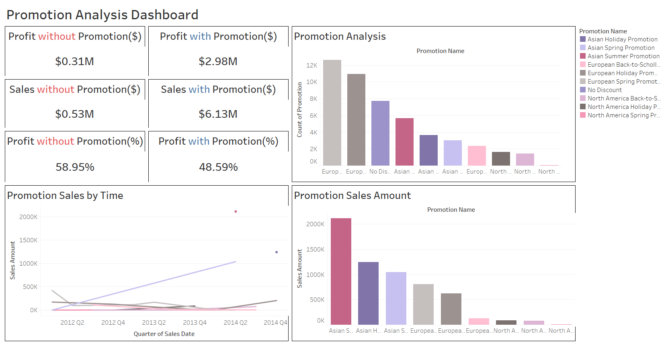
PROMOTIONAL ANALYSIS
DASHBOARD FOR PROMOTIONAL ANALYSIS

Slide 8
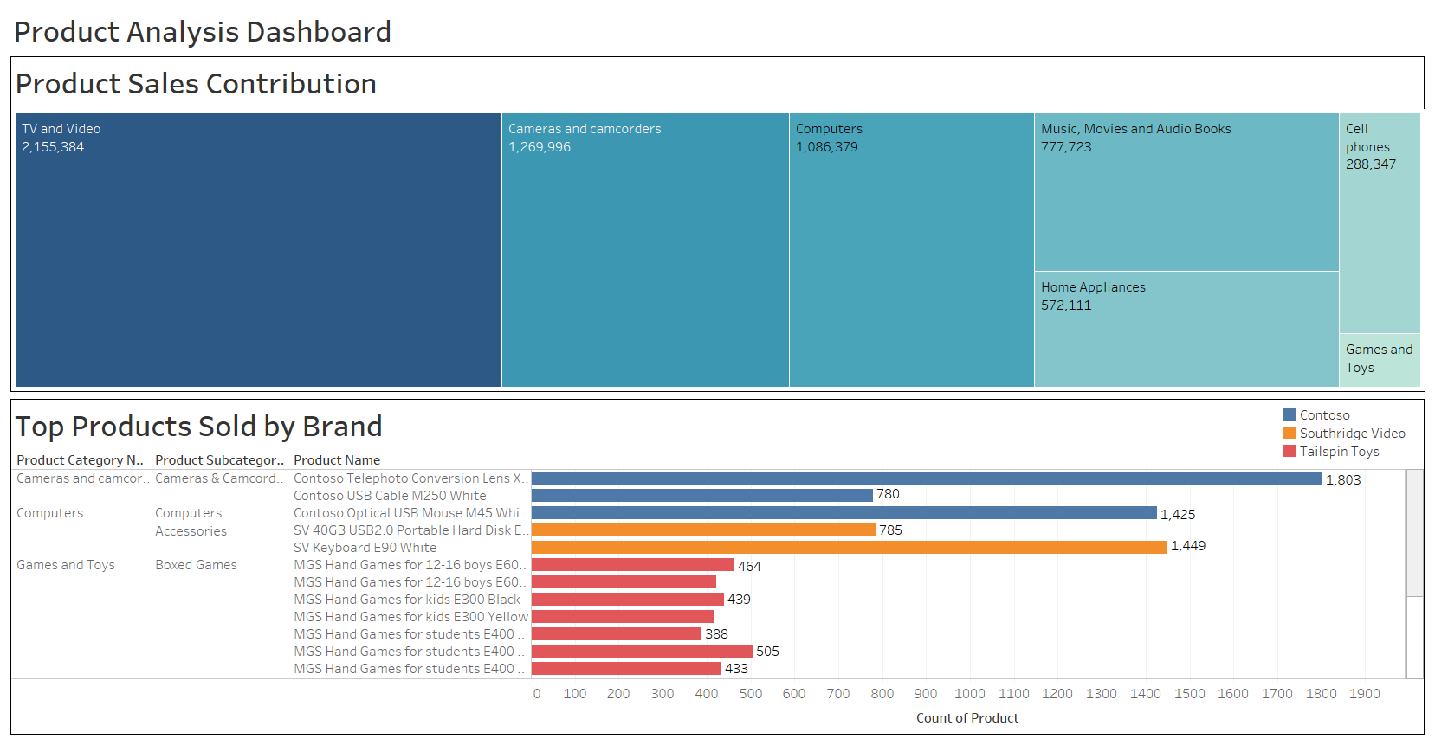
PRODUCT ANALYSIS
DASHBOARD FOR PRODUCT ANALYSIS

Slide 9
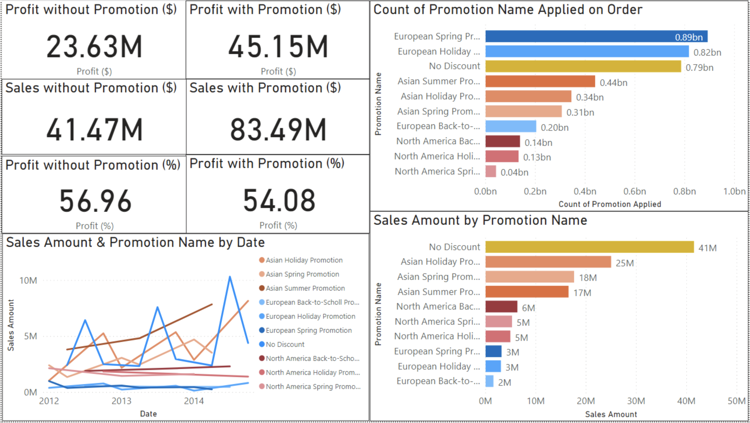
OVERALL SALES ANALYSIS

Slide 10
THANK YOU

